Slide 1
Group no - 19 Sentiment Analysis - Amazon Product Reviews
Varun Jasani

Slide 2
Introduction
The practice of evaluating text to ascertain the emotional tone of the author's message is known as sentiment analysis. Sentiment analysis is the process of examining customer reviews of products on Amazon to ascertain whether they are positive, negative, or neutral.
In this project, we will examine Amazon product reviews using sentiment analysis techniques. Machine learning techniques will be used to determine the sentiment that each review expresses. The objective is to offer perceptions of consumer preferences and opinions about a certain product, which can be utilized to support data-driven decisions to enhance the product or create successful marketing campaigns.

Slide 3
Dataset description
It consists of more than 500K reviews.
It consists of both numerical and text data.
There are 10 columns and 568,454 rows.
Reference link:
http://www.kaggle.com/datasets/arhamrumi/amazon-product-reviews

Slide 4


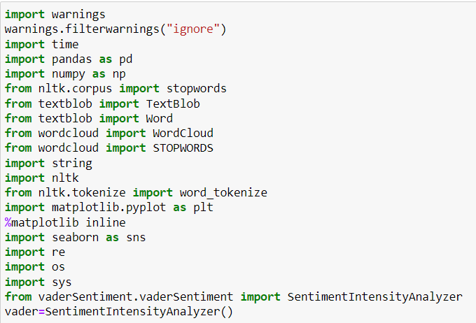
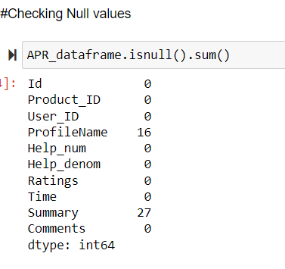
Methodology
Step 1: Importing all the libraries
Step 2: After loading the data, we checked for the null values and then we ran a code to remove the null values from our dataset, and then we recheck the dataset to check if any null value is still present or no

Slide 5
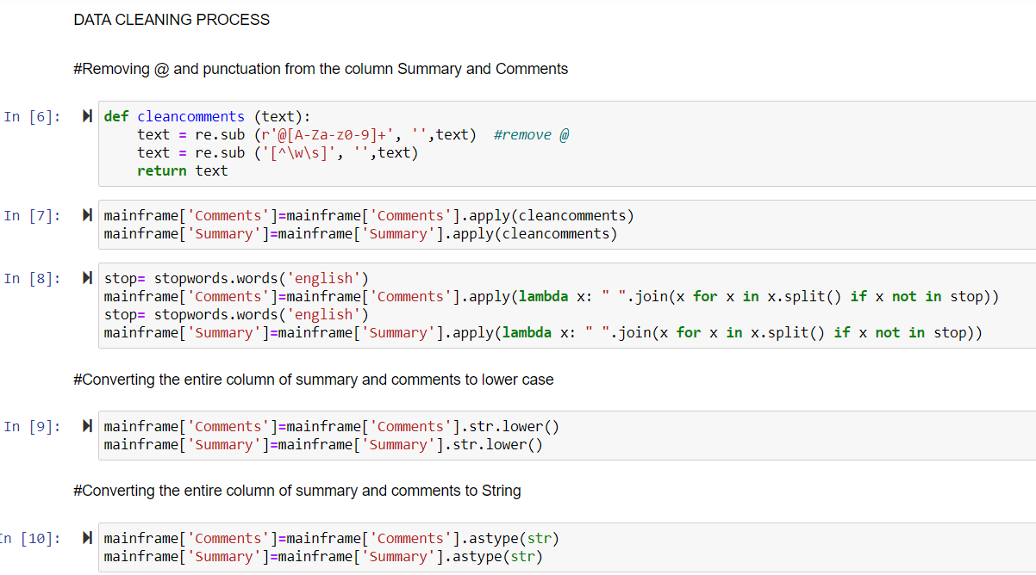
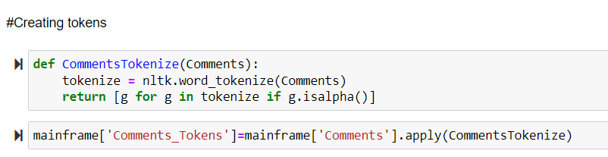
Step 3: Then we moved to the step of data cleaning wherein we created functions to remove the punctuation marks and signs and symbols which are not required.
Step 4: After removing the punctuation and unnecessary symbols from the comments we ran a function to change reviews into plain text format Step 5: Later we converted the reviews to lowercase for ease and then we converted the reviews to string format. Step 6: Then we separated each word in the reviews and assigned them to individual tokens

Slide 6
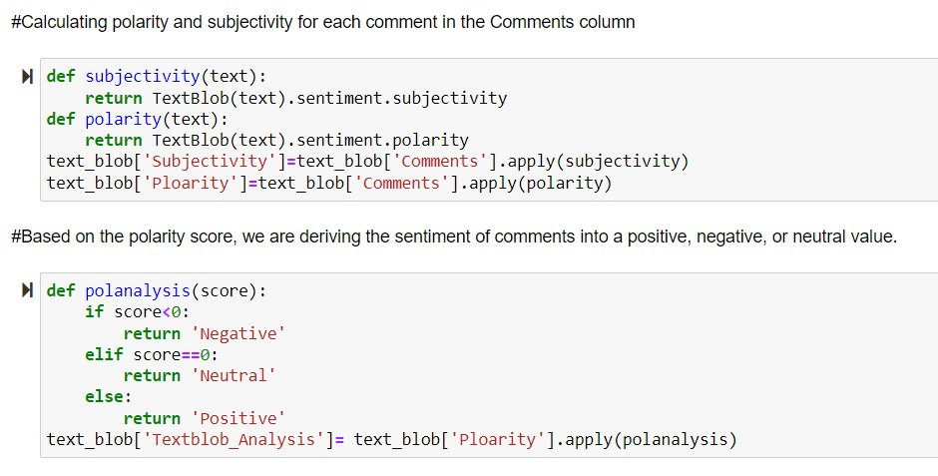
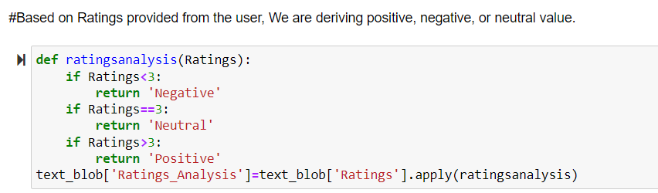
Step 7: We then created 2 functions named “subjectivity” and “polarity” and using the features of textblob we got the polarity score which ranges between -1 and 1, where -1 is the most negative and 1 is the most positive.
Step 8: The reviewers have given number ratings as well to their reviews so now we use those numbers directly use those numbers and consider the reviews as positive, negative or neutral based on the numbers where if the rating is 2 or less than 2 it will be considered as negative, if the number is 3 it will be considered as neutral and if the rating is 3 or more than 3 it will be considered as positive.

Slide 7
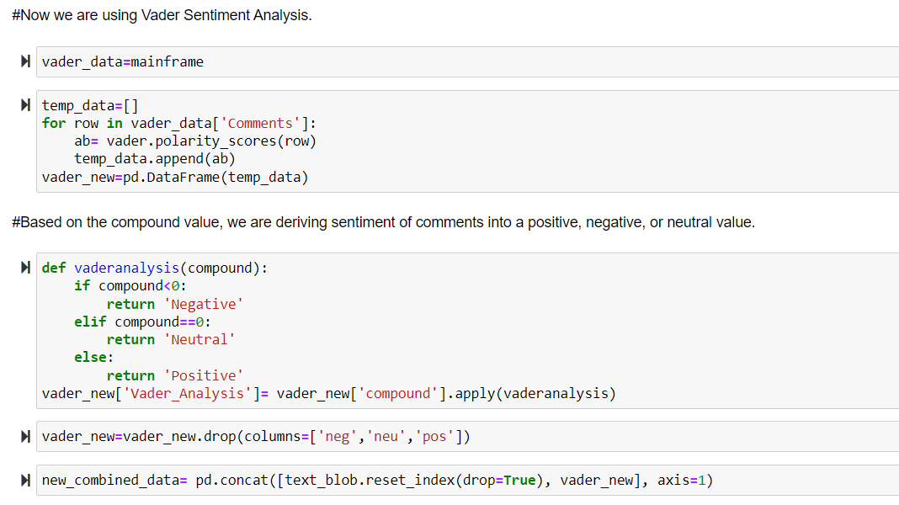
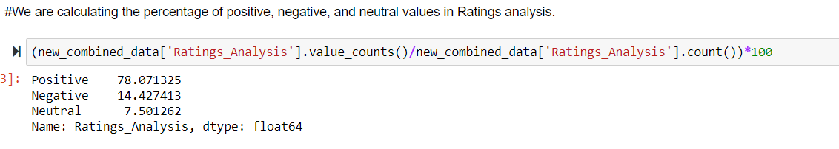
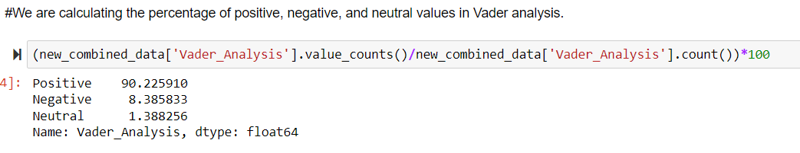
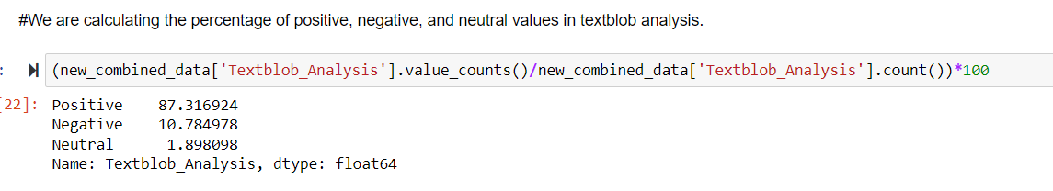
Step 9: Now we use the Vader sentiment analysis on the same reviews, it divides the reviews into 4 columns Negative, Positive, Neutral and compound column, the compound column gives a compounded value.
Step 10: Then we extracted the percentages of all 3 techniques that is Vader analysis, Textblob analysis and analysis of the ratings of the review and we compared the percentages of all 3 analysis.

Slide 8
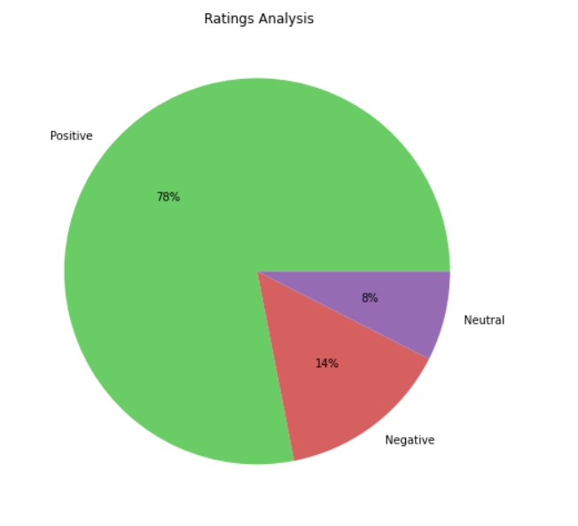
Step 11: visualization – pie chart
Pie chart for ratings analysis

Slide 9
Step 12:
Pie Chart for Ratings analysis

Slide 10
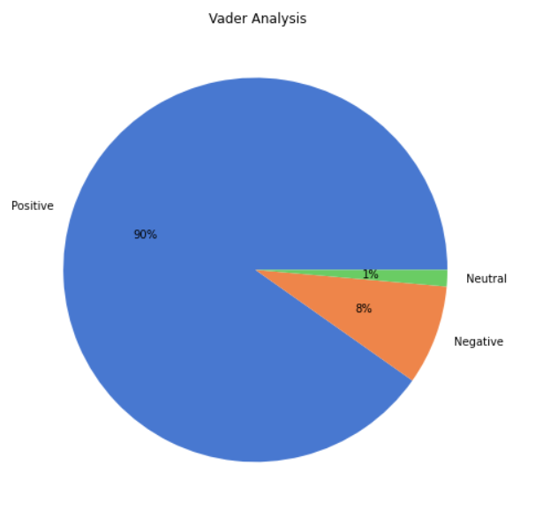
Step 13:
Pie Chart for vader analysis

Slide 11
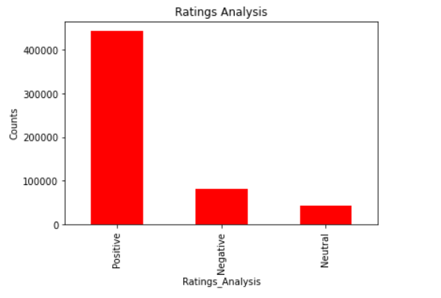
Visualization: bar graphs
Step 14:
Bar graph for ratings analysis

Slide 12
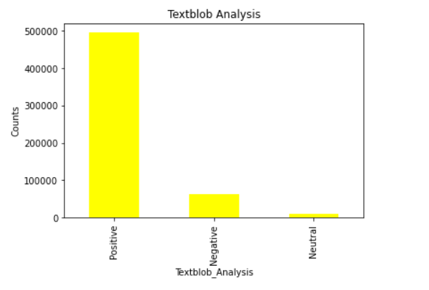
Step 15:
Bar chart for textblob analysis

Slide 13
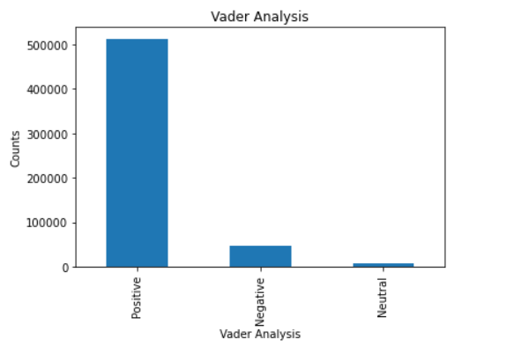
Step 16:
Bar chart for vader analysis

Slide 14
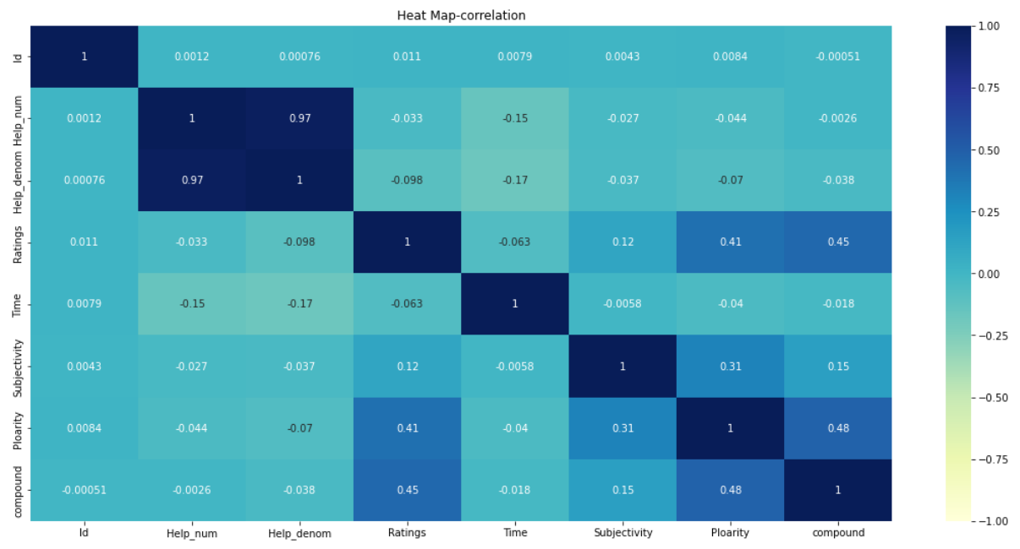
Step 17:
Heatmap for the co-relation

Slide 15
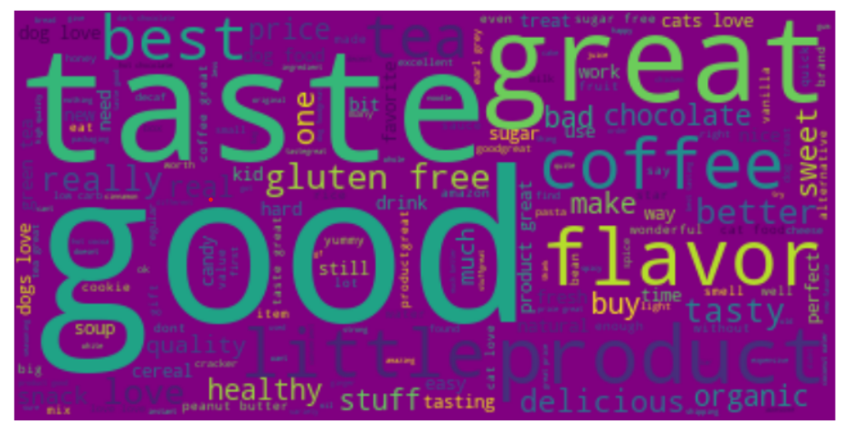
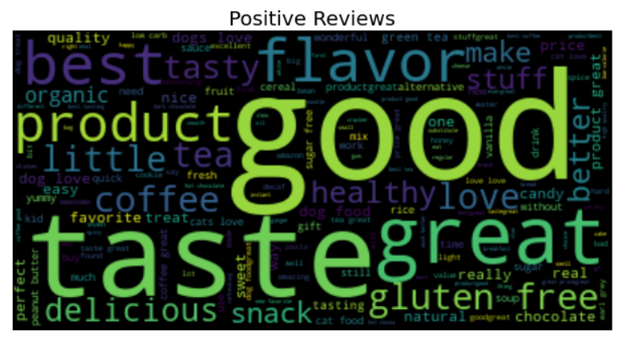
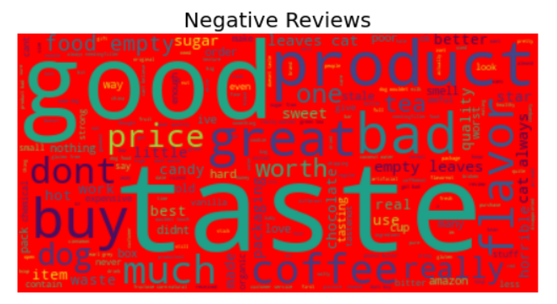
Step 18: Wordcloud for generic, positive and negative reviews

Slide 16
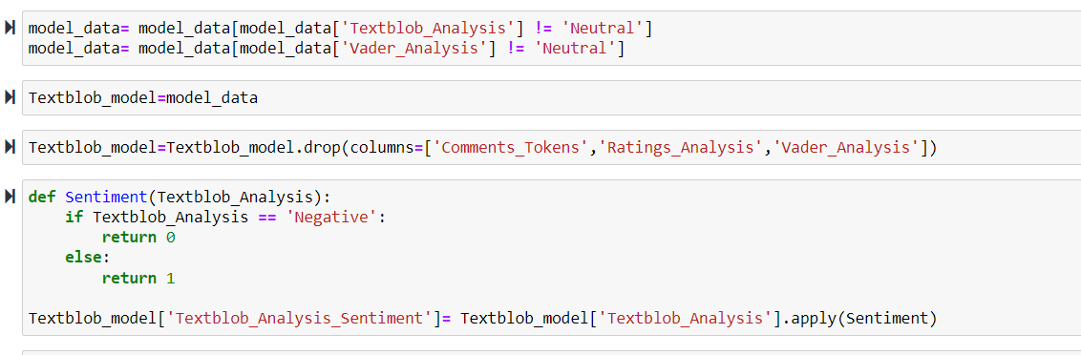
Step 19: First, we remove all the unnecessary columns which are not going to be used in the M.L Models.
Step 20: Then we discard the reviews which are neutral.
Step 21: Then we assign values 0 and 1 to the negative and positive reviews respectively.

Slide 17
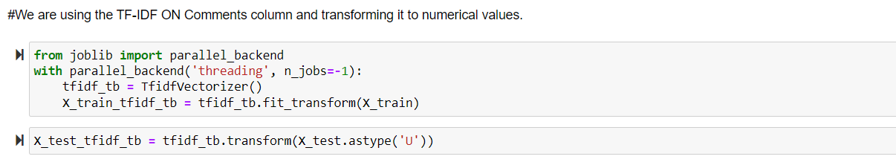
Step 22: We now insert the text from the reviews in X_train and we insert the sentiment score in the Y_train
Now to fit the data in the machine learning model we have transformed the data by using TF-IDF, using this, each word in the string has been assigned a numerical value so that it fits perfectly in the machine learning model.

Slide 18
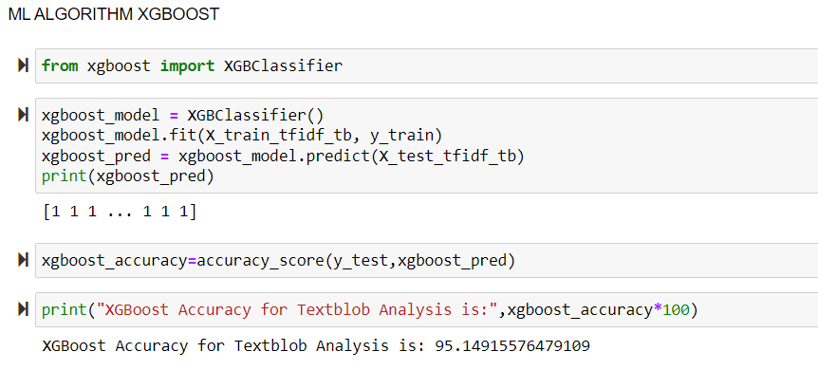
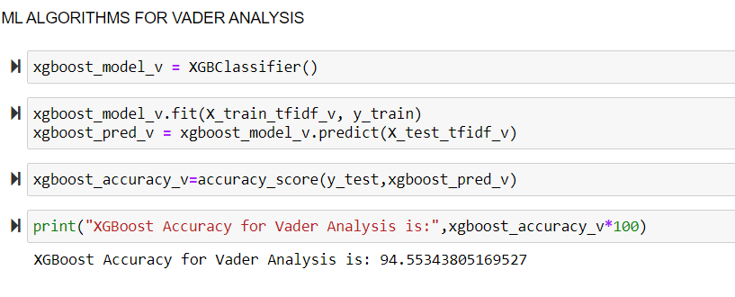
Machine Learning Algorithm Application
Step 23: Applying XGBoost algorithm

Slide 19
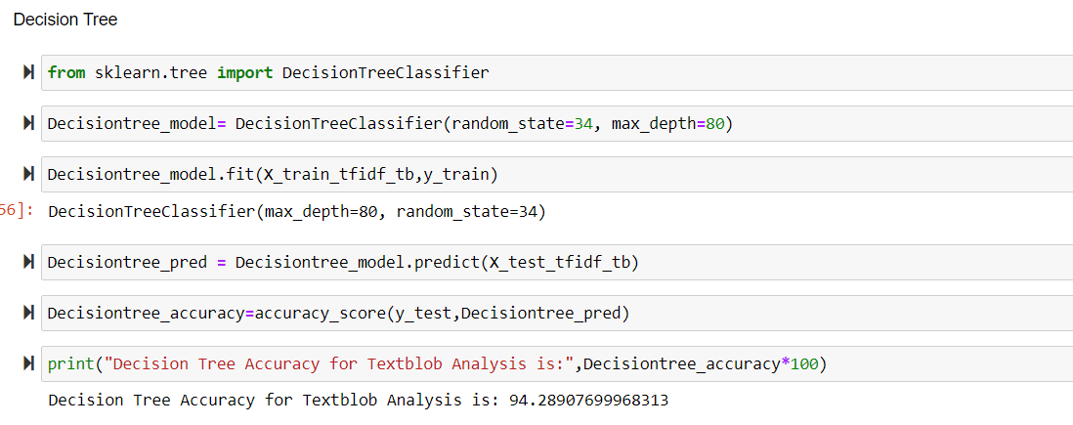
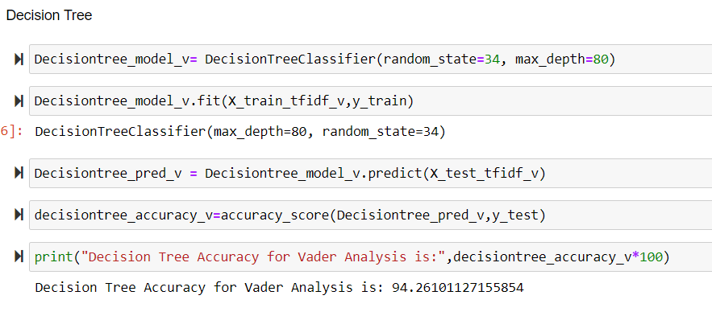
Step 24: Applying decision tree algorithm

Slide 20
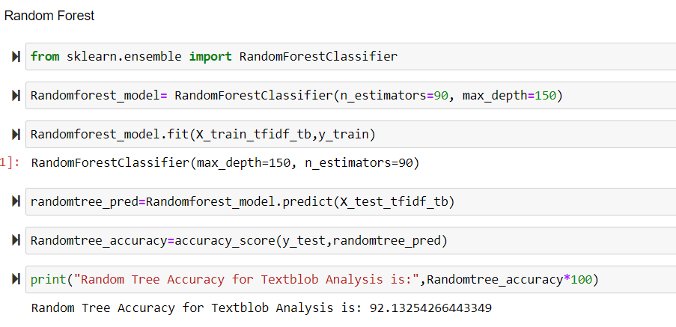
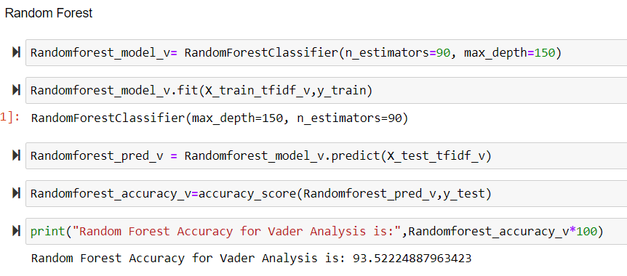
Step 25: Applying random forest algorithm

Slide 21
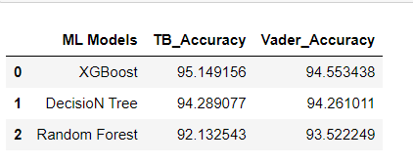
Comparisons / Conclusion:
XGBoost - Textblob Analysis - 95.14%
XGBoost - Vader Analysis - 94.53%
Decision Tree - Textblob Analysis - 94.28%
Decision Tree - Vader Analysis - 94.26%
Random Forest - Textblob Analysis - 92.13%
Random Forest - Vader Analysis - 93.52%

Slide 22
References
https://machinelearningmastery.com/develop-first-xgboost-model-python-scikit-learn/
https://youtu.be/AnvrJNLKp0k
https://youtu.be/TRnPslOCbv0
https://youtu.be/Alu_cCXNS-k

Slide 23


Thank you

